Slide 1
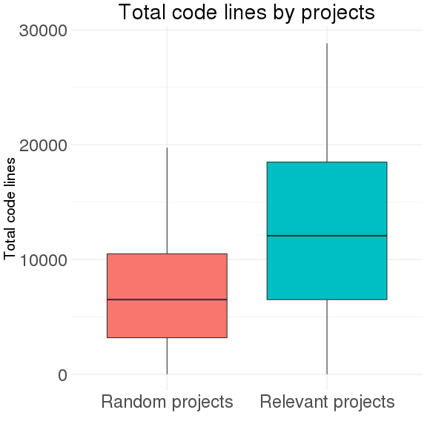
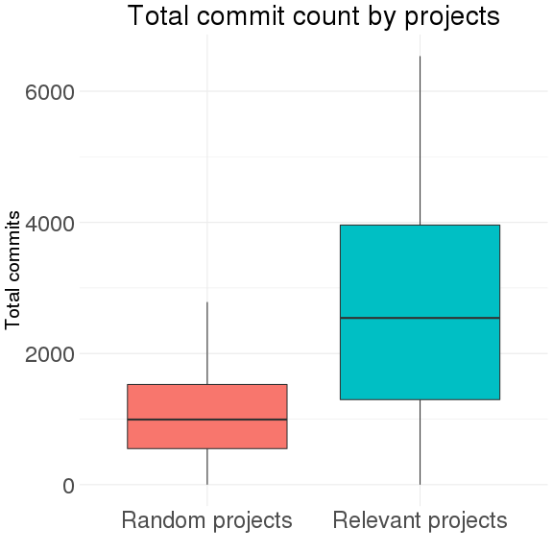
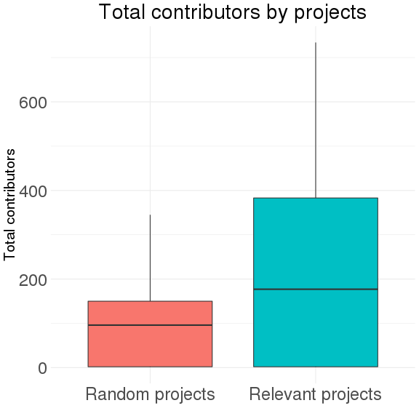
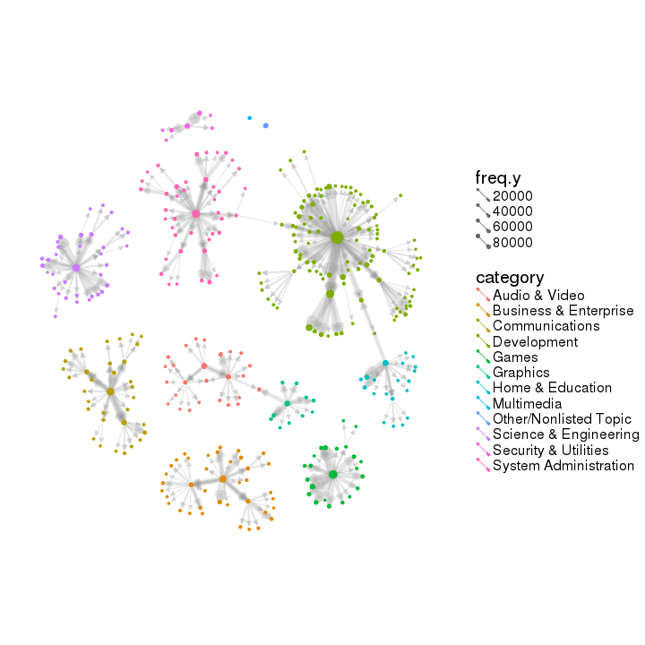
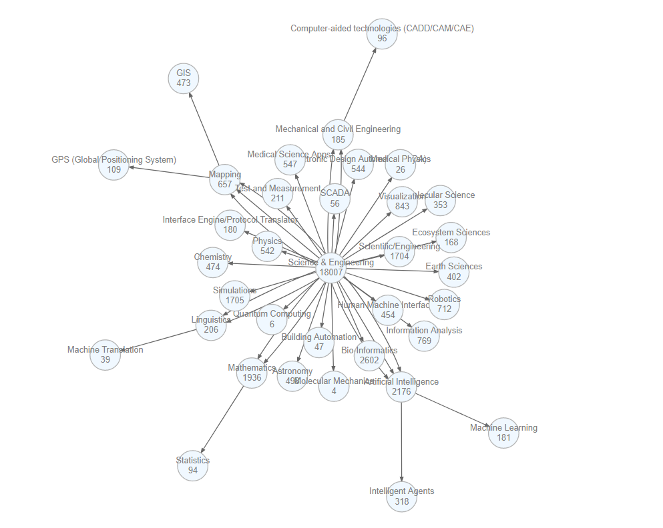

EXPLORING The scope AND IMPACT of
OPEN SOURCE software
Eirik Iversen (VT), Ben Swartz (VT), Claire Kelling (PSU), Sayali Phadke (PSU)
with Gizem Korkmaz and Stephanie Shipp (SDAL)
Sponsor: Carol Robbins, The National Center for Science & Engineering Statistics at NSF
Project Description
The project aims to test the feasibility and to develop methods to measure the scope and impact (e.g., cost and benefit) of Open Source Software (OSS). Our goal is to understand how much OSS is in use (stock) and how much is created (flow). We use two data sources, OpenHub and SourceForge, to characterize the development and the categories (users) of OSS, respectively.
OpenHub
OpenHub is an online community and public directory of free and open source software. Source repositories include information on:
Projects (~676,523): development info & activity, contributors, users, commits
Organizations (698): portfolio projects (2850), contributors, organization info.
People (~291,782): contributions, user information, project usage
We used their API (Application Programing Interface) to collect information on:
a subset of the most relevant projects, determined by OpenHub (8.2% of all projects)
a randomly selected subset (6.8% of all projects)
SourceForge
SourceForge is an “open source community resource” for development and distribution. It includes information on:
Projects (~450,000) registered over the span of 18 years (1999-2017)
Contributors (~350,000)
We used their API to collect the project names. Detailed information on each project was collected continuously over 17 days using web-scraping.
Top Downloaded Softwares | Category | Number of Downloads
Microsoft’s TrueType core fonts | Development | 2,079,351,723
Notepad++ Plugin Manager | - | 1,481,067,341
VLC Media Player | Communications | 898,907,923
Other Selected Softwares | Category | Number of Downloads
7-Zip (9th) | System Administration | 412,199,932
Apache OpenOffice (11th) | Development | 238,646,302
PDF Creator (16th) | Business & Enterprise | 113,284,095
Weka -machine learning- (154th) | Science & Engineering | 8,797,668
Categories and Subcategories
Projects in SourceForge are structured with three levels of categories. Categories and respective top subcategories are given in the table on the right.
The figure below illustrates that the number of projects per category and the average download by category vary.
Category | Top Subcategories
Audio & Video | Sound/Audio (68%), Video (27%)
Business & Enterprise | Enterprise (27%), Financial (24%)
Communications | Chat (32%), Email (21%)
Development | WWW/HTTP (26%), Software Development (8%)
Games | Games/ Entertainment (23%), Role-Playing (13%)
Graphics | 3D Rendering (19%), 3D Modeling (12%)
Home & Education | Education (39%), Computer Aided Instruction (15%)
Science & Engineering | Bio-Informatics (14%), Artificial Intelligence (12%)
Security & Utilities | Security (59%), Cryptography (35%)
System Administration | Networking (19%), Storage (15%)
Network of Categories
We use the category and subcategories of each project on SourceForge to generate the network of categories.
The full network, shown on the right, includes 346 nodes (i.e., categories), and 467 directed edges.
Multimedia
Security & Utilities
Other/Nonlisted Topic
Science & Engineering
System Administration
Development
Communications
Audio & Video
Graphics
Home & Education
Business & Enterprise
Games
The full network above provides an impression of the overall scope, and the subnetwork of Science and Engineering is presented on the left.
Challenges and Next Steps
Challenges include computational complexity and data quality issues.
Future work involves collecting a larger dataset from OpenHub and developing methods to measure the impact of OSS.

